Slide 1
Secure Network Togologies

Slide 2



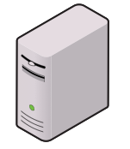


DMZ
Demilitarized zone
Additional layer of security between the internet and you
Public access to public resources
Not on organization’s internet network
Internet

Slide 3

Extranet
A private network for partners
Remote vendors, suppliers
Requires additional authentication, VPN
Internet

Slide 4
Intranet
Internal, private network
Employees only
Sharing business computing resources
Internet

Slide 5
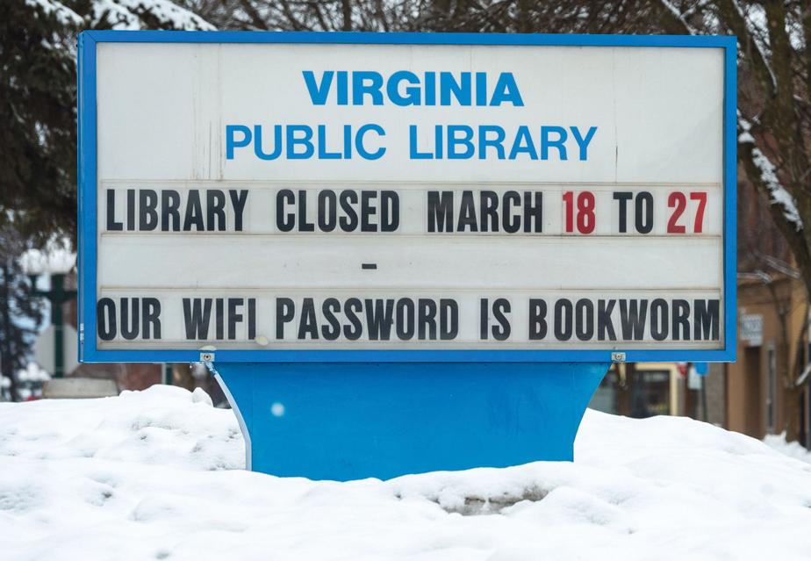
Wireless networking
Convenience – no wires
Security concerns – anyone can hop on
Internal use
Configure a separate wireless network for guests
Users authenticate to wireless network
Use normal network login credentials
802.1X standard
Integrated into existing services
No wireless passphrase
Which are always shared and widely known!

Slide 6
Guest network
Optional network
Convenient to provide for meetings, demonstrations, etc.
No access to the internal network
Walled off from corporate resources
Internet access only
Integrated with a captive portal
Avoid unauthorized use of the network
Useful in congested areas
Keeps employees of the guest network
Limits support calls “I can’t print”, “I can’t access ___”

Slide 7
Ad hoc
Wireless without an access point
Common on mobile devices
AirDrop, contact sharing apps
Difficult to control on unmanaged devices
Disable ad hoc settings with Mobile Device Management
Implement network access control
Possible to use ad hoc but only with the right credentials
Limit application use for ad hoc

Slide 8
Honeypots and honeynets
Tempting target for malicious users
Who are probably a machine
Makes for interesting recon
“How are they trying to get in now?”
Honeypots
Single-use/single-system traps
Honeynets
Multiple honeypots on a single network
More than one source of information

Slide 9
Network Address Translation
Estimated that there are over 20 billion devices connected to the internet (and growing)
IPv4 supports 4.29 billion addresses
The address space for IPv4 is exhausted
No more addresses available
How does it all work
Network Address Translation
Router acts are surrogate for public internet traffic then translates each packet between public and private network addresses

Slide 10
NAT and security
NAT is not a security mechanism
Security through obscurity
The premise: If you can’t see it, you can’t attack it
Not security at all
Malicious users can circumvent an unprotected NAT
Sophisticated attacks assume NAT is in use
They can gain access to internal devices even with NAT in place
A stateful firewall is the security mechanism
Used in conjunction with NAT to provide security

